Slide 1
INTRODUCTION TO ECONOMICS

Slide 2
CHAPTER ONE
FUNDAMENTALS OF ECONOMICS

Slide 3
1.1. DEFINITION AND NATURE OF ECONOMICS
The word economics comes from the ancient Greek word oikonomia.
oikos=>house
nomos =>rule or custom
So oikonomia means rule of house(household) or management of household administration.
Two fundamental facts together provide a foundation for Economics:
1. Society’s material want are unlimited.
2. Economic resources are limited in supply or scarce

Slide 4
Cont…
By society’s material wants we refer to the desire of consumers, business (firms), and government to get those things that help them realize their respective goals.
The goal of the consumer is to get maximum satisfaction, the goal of the business is to produce goods and services for profit and the goal of the government is to satisfy the collective wants of its citizens.

Slide 5
Cont…
Human wants are not only numerous but also expand and diversify through time. Therefore, human wants are unlimited.
Resource is anything natural or man made that can be used in production of goods and services.
Thus, economic resources are the means to produce goods and services. Examples are various types of labor, oil deposits, minerals, building, communication facilities etc.
All these resources are scarce or limited in supply.

Slide 6
Cont…
These two contradictory facts lay the foundation for the field of Economics
Economics is thus a science which studies the allocation of scarce resources in production, consumption and distribution of goods and services to attain the maximum fulfillment of society’s material wants.
Economics is concerned with “doing the best with what we have”.

Slide 7
Cont…
From the above definition we understand the Following points.
1. Economics is Science
2. The society faces a problem of scarcity
3. There is a problem of choice

Slide 8
The scope of Economics
From the point of view of elements of analysis, economics has two major branches: microeconomics and macroeconomics
Microeconomics
Deals with economic behaviors of individual economic units such as consumers, producers, business firms and other economic decision making units
Deals with how the market of individual commodities function

Slide 9
Cont…
It is concerned also with interaction among the economic units
B. Macroeconomics
Is branch of economic analysis concerned with the economy as a whole and sub aggregates of the economy.
Macroeconomics deals with aggregate units of national economy such as national output or Gross National Product (GDP), general price level, inflation and national employment.

Slide 10
Cont…
Like macroeconomics ,microeconomics also uses aggregates. But in microeconomics we aggregate over the homogeneous product but in macroeconomics the aggregation is at the economy level

Slide 11

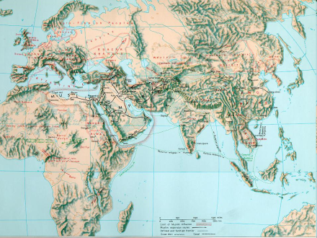
Basic Classifications of Economics
Macroeconomics
The big picture. Study of the operation of the economy as a whole. It looks at aggregate data.
Microeconomics
“A small-scale study”. Focuses on individual entities of the economy, such as households and firms.
Focuses more at the policy and regulatory levels.
focuses at the firm level
Both areas offer valuable outlook on the economy.

Slide 12
Table 1. Comparison between Microeconomics and Macroeconomics
Microeconomics | Macroeconomics
Households’ and/or firms’ economic behavior | National economy
Price of individual items or firms | General price level
Price of a consumption good | Consumer price index (CPI)
An increase in price of a commodity | Inflation
Output of a factory or a firm | National output or GDP

Slide 13
Cont…
Microeconomics | Macroeconomics
Output of a factory or a firm | National output or GDP
Wage rate in an enterprise | National wage rate
Investment of individual firm | National Investment
Consumption of households or individuals | National Consumption
Firm’s expense or households’ expenses | Government expenditure

Slide 14
1.2. Scarcity and Choice
Scarcity –refers to all economic resources, that a society needs to produce goods and resources, are finite or limited in supply
It refers to the imbalance between our wants and a means to satisfy these wants.
Resources can be classified as free and economic resources
A resource is said to be free if the amount available to society is greater than the amount people desire at zero price.

Slide 15
Cont…
A resource is said to be scarce or economic resource if the amount available to society is less than the amount people desire at zero price
Economic resource can also be divided into four categories
i. Labor iii. Capital
ii. Land iv. Entrepreneurship

Slide 16
Cont…
Labor
refers to the physical as well as mental effort of human beings in production and distribution of goods
This includes both the skilled and unskilled labor
The reward for labor is called wage

Slide 17
Cont…
ii. Land
refers to the natural resources or all the free gifts of nature
It doesn’t include those resources that are transformed, altered or improved by human beings
The reward/payment for land is called rent

Slide 18
Cont…
iii. Capital
refers to all manufactured inputs that can be used to produce other goods and services
it refers to physical capital only. It doesn’t take in to account financial capital
The reward for capital is called interest

Slide 19
Cont…
iv. Entrepreneurship
refers to a special type of human talent that helps to organize, manage factors of production to produce goods and services
Takes risk of making losses
The reward for an entrepreneur is profit

Slide 20
Cont…
The same logic(definition of scarce or free resource ) is applicable for goods and services
A good is said to be scarce or economic good if the amount available to society is less than the amount people desire at zero price
A good is said to be free good if the amount available to society is greater than the amount people desire at zero price

Slide 21
Cont…
NB:scarcity doesn’t mean shortage
Shortage | Scarcity
Specific problem | Universal problem
Short term phenomena | Everlasting phenomena

Slide 22
Cont…
Scarcity implies choice
Choice in turn implies cost(sacrification)
The cost is the forgone opportunity
Opportunity cost/opportunity lost/: is the value of the next best alternative that must be given up in order to obtain one more unit of the first product

Slide 23
Production Possibility Frontier(PPF)
PPF is a graph that shows the various combinations of output that the economy can possibly produce given the available factors of production and the available production technology
Assumptions to draw the PPC/PPF
i. Efficiency
ii. Fixed resource
iii.Two products
iv. Fixed technology

Slide 24
Cont…
Although real economies produce thousands of goods and services, let’s imagine an economy that produces only two goods—cars and computers
Together the car industry and the computer industry use all of the economy’s factors of production

Slide 25
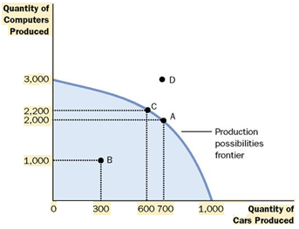
Cont…
Figure 1

Slide 26
Cont…
Figure 1 is an example of a production possibilities frontier. In this economy, if all resources were used in the car industry, the economy would produce 1,000 cars and no computers
If all resources were used in the computer industry, the economy would produce 3,000 computers and no cars

Slide 27
Cont…
The two end points of the production possibilities frontier represent these extreme possibilities
If the economy were to divide its resources between the two industries, it could produce 700 cars and 2,000 computers, shown in the figure by point A
Points on PPF are attainable and efficient

Slide 28
Cont…
By contrast, the outcome at point D is not possible because resources are scarce: The economy does not have enough of the factors of production to support that level of output
In other words, the economy can produce at any point on or inside the production possibilities frontier(attainable but inefficient)
the economy cannot produce at points outside the frontier(Unattainable)

Slide 29
Cont…
The production possibilities frontier shows one tradeoff that society faces.
Once we have reached the efficient points on the frontier, the only way of getting more of one good is to get less of the other. When the economy moves from point A to point C
For instance, society produces more computers but at the expense of producing fewer cars

Slide 30
Cont…
Another Principles of Economics that is shown through the production possibility frontier is opportunity cost
The opportunity cost of a commodity means the amount of a next best alternative that must be sacrificed in order to obtain one more unit of the commodity
The production possibilities frontier shows the opportunity cost of one good as measured in terms of the other good
When society reallocates some of the factors of production from the car industry to the computer industry, moving the economy from point A to point C, it gives up 100 cars to get 200 additional computers. In other words, when the economy is at point A, the opportunity cost of 200 computers is 100 cars

Slide 31
Cont…
Opportunity = The amount of the good scarified
The amount of the good gained
Law of Increasing Opportunity Cost – For each additional unit of a good produced the opportunity cost increases. Why?
Because the most efficient use of the resource in production of a good is used first.

Slide 32
Cont…
Is there any mechanisms to produce outside the production possibility frontier? Or contraction ?
Economic Growth (Causes):
1. Capital accumulation (human, capital goods)
2. Technological progress (change, ideas)
Contraction of PPF (Causes):
1. Droughts
2. Floods
3. Earthquakes

Slide 33
Cont…
For example, if a technological advance in the computer industry raises the number of computers that a worker can produce per week, the economy can make more computers for any given number of cars. These can be presented graphically as follows;

Slide 34
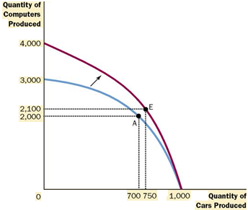
Cont…
Figure 2

Slide 35
Cont…
As a result, the production possibilities frontier shifts outward, as in Figure 2.
Because of this economic growth, society might move production from point A to point E, enjoying more computers and more cars.

Slide 36
Cont…
A change in technology can symmetrical or asymmetrical
If the change is in one sector =>Asymmetrical
If the change is in both sectors =>symmetrical

Slide 37
1.3.The Basic Economic Questions and Alternative Economic systems
There are three basic economic problems that any economic unit needs to answer:
What to produce: Types and amounts of commodities to be produced
How to produce: the answer to this question may help determine what production method or technique to use and what input to use. For instance the decision may be about identifying the best combinations of inputs or raw materials

Slide 38
Cont…
C.For whom to produce: This question helps us to identify potential customers

Slide 39
Alternative Economic systems
Economic system
Is a set of organizational and institutional arrangements
Established to answer the basic economic questions
There are three types of economic systems
Market economy
Command economy
Mixed economy

Slide 40
A. Market Economy
The private ownership of resources and the use of markets and prices to coordinate and direct economic activity characterize the market system, or capitalism.
In this system each participant acts in his or her own self-interest; each individual or business seeks to maximize its satisfaction or profit through its own decisions regarding consumption or production

Slide 41
Cont…
The system allows for the private ownership of capital, communicates through prices, and coordinates economic activity through markets
Goods and services are produced and resources are supplied by whoever is willing and able to do so
The result is competition among independently acting buyers and sellers of each product and resource

Slide 42
Summary of Market economy
Producers and consumer determine WHAT, HOW, and FOR WHOM to produce.
Advantages =
1. ability to adjust to change;
2. the high degree of individual freedom (start a business, the ability to work nights, part time job, two jobs)
3. the small degree of government involvement;
4. the ability to have a voice in the economy;
5. the variety of goods and services created;
6. the high degree of consumer satisfaction
7. high standard of living

Slide 43
Cont…
Disadvantages =
1. inability of the market to meet every person’s basic needs *(market failure)
2. inadequate job in providing highly valued services like justice, education, and health care
3. high level of personal uncertainty and the prospect of economic failure………failure to stabilize the economy

Slide 44
B. Command Economic System
The alternative to the market system is the command system, also known as socialism or communism.
In this system, the government owns most property resources and economic decision making occurs through a central economic plan.
A central planning board appointed by the government makes nearly all the major decisions concerning the use of resources, the composition and distribution of output, and the organization of production

Slide 45
Cont…
The government owns most of the business firms, which produce according to government directives.
A central planning board determines production goals for each enterprise and specifies the amount of resources to be allocated to each enterprise so that it can reach its production goals

Slide 46
Cont…
The division of output between capital and consumer goods is centrally decided, and capital goods are allocated among industries on the basis of the central planning board’s long-term priorities.

Slide 47
Summary of command Economy
A central authority determines WHAT, HOW and FOR WHOM to produce
Examples: North Korea, Cuba, People’s Republic of China (and the former Soviet Union)
Advantages
Fair distribution of income
Absence of business fluctuation
Absence of private monopolistic practices
Disadvantages =
1. consumer needs may not be met;
2. hard work is not rewarded;
3. necessary decision-making bureaucracy delays decision;
4. little flexibility to deal with day-to-day problems;
5. individual initiative goes unrewarded (i.e. entrepreneurs need not apply)

Slide 48
C. Mixed Economic Systems
Pure capitalism and command economy are the two extreme types of economic systems.
The mixed economic system takes the strong elements of the two economic systems

Slide 49
1.4. Decision making unit and circular flow of economic activities
There are three decision-making units in closed economy.
i. Households-is an economic unit which provides an economy with resources and uses the money paid to it to buy goods and services to satisfy its material wants.
ii. Firm- a firm is production unit that uses economic resources to produce g + s and sell them to hhs, other firms and gov’t.

Slide 50
Cont’d
Firms makes to decisions:
1. buying of economic resources
2. Selling of their products
iii. Government
These economic agents interact in two markets
i. Resource/input markets
ii. Products/output markets

Slide 51
Cont…
We can use two models to understand the economic interaction among economic agents
a. Two sector circular flow model
b. Three sector circular flow model

Slide 52
CIRCULAR FLOW OF ECONOMIC ACTIVITY(TWO SECTOR MODEL)
HOUSEHOLDS
FIRMS

Slide 53
CIRCULAR FLOW OF ECONOMIC ACTIVITY
PAYMENTS FOR GOODS AND SERVICES
HOUSEHOLDS
FIRMS

Slide 54
CIRCULAR FLOW OF ECONOMIC ACTIVITY
PAYMENTS FOR GOODS AND SERVICES:
FIRMS’ REVENUE
HOUSEHOLDS
FIRMS
WAGES, SALARIES,PROFITS,& RENT:
FIRMS’ COSTS OR FACTOR PAYMENTS

Slide 55
CIRCULAR FLOW OF ECONOMIC ACTIVITY
PAYMENTS FOR GOODS AND SERVICES:
FIRMS’ REVENUE
LABOR,CAPITAL,LAND&
ENTREPRENEURSHIP
HOUSEHOLDS
FIRMS
WAGES, SALARIES,PROFITS,& RENT:
FIRMS’ COSTS OR FACTOR PAYMENTS

Slide 56
CIRCULAR FLOW OF ECONOMIC ACTIVITY
PAYMENTS FOR GOODS& SERVICES:
FIRMS’ REVENUE
LABOR,CAPITAL,LAND &
ENTREPRENEURIALSHIP
HOUSEHOLDS
FIRMS
REAL GOODS & SERVICES
WAGES , SALARIES,PROFITS,& RENT:
FIRMS’ COSTS

Slide 57
CIRCULAR FLOW OF ECONOMIC ACTIVITY(THREE SECTOR MODEL)
PAYMENTS FOR GOODS& SERVICES:
FIRMS’ REVENUE
LABOR,CAPITAL,LAND &
ENTREPRENEURIALSHIP
HOUSEHOLDS
FIRMS
REAL GOODS & SERVICES
WAGES, SALARIES,PROFITS,& RENT:
FIRMS’ COSTS OR FACTOR PAYMENTS
SUBSIDIES
SUBSIDIES
GOV’T
TAXES
TAXES

Slide 58
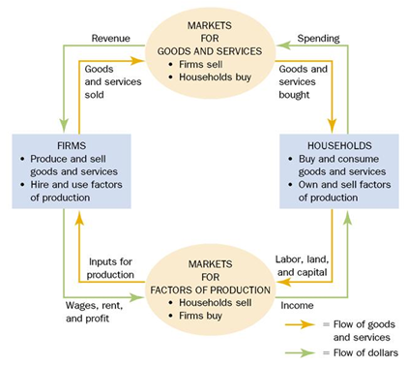
Two sector circular flow model

Slide 59
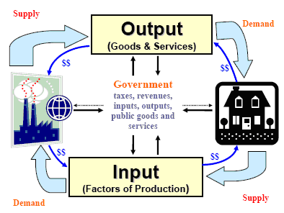
Three sector circular flow model

Slide 60
THE END

